Slide 1
The Pricing Strategy of O2O Takeaway Food Industry
——Using Hotelling Model
Speaker: Li, Yijia

Slide 2

Observation
Duopoly & Two-sided

Slide 3
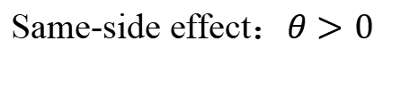
The effect of “more consumers”
Cross-side effect：𝜆 > 0
More consumers->
More orders -> More revenue
Same-side effect：$θ>0$
More consumers->
More comments and reviews

Slide 4
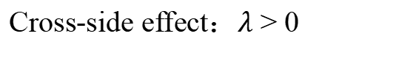
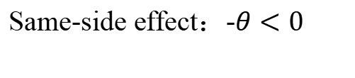
The effect of “more restaurants”
Same-side effect：-$θ<0$
More restaurants
More competitors
Cross-side effect：$\text{λ}\text{ > }\text{0}$
More restaurants
More choices for consumers

Slide 5


Model-Descriptions
0
1
Uniform Distribution

Slide 6
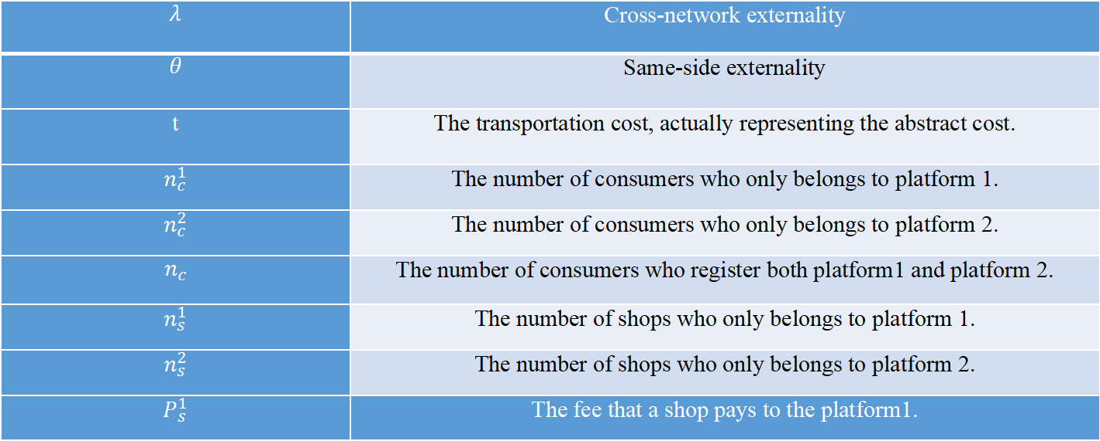
Model-Variables
$$λ$$ | Cross-network externality
$$θ$$ | Same-side externality
t | The transportation cost, actually representing the abstract cost.
$$n_{c}^{1}$$ | The number of consumers who only belongs to platform 1.
$$n_{c}^{2}$$ | The number of consumers who only belongs to platform 2.
$$n_{c}$$ | The number of consumers who register both platform1 and platform 2.
$$n_{s}^{1}$$ | The number of shops who only belongs to platform 1.
$$n_{s}^{2}$$ | The number of shops who only belongs to platform 2.
$$P_{s}^{1}$$ | The fee that a shop pays to the platform1.
$$P_{c}^{1}$$ | The fee that a consumer pays to the platform1.
$$P_{s}^{2}$$ | The fee that a shop pays to the platform2.
$$P_{c}^{2}$$ | The fee that a consumer pays to the platform1.

Slide 7

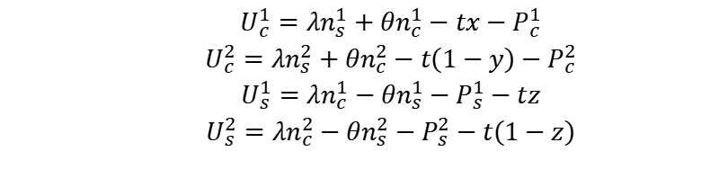
Model-Calculations
Utility Function
$$\begin{aligned}U_{c}^{1}=λn_{s}^{1}+θn_{c}^{1}−tx−P_{c}^{1} \\ U_{c}^{2}=λn_{s}^{2}+θn_{c}^{2}−t\left(1−y\right)−P_{c}^{2} \\ U_{s}^{1}=λn_{c}^{1}−θn_{s}^{1}−P_{s}^{1}−tz \\ U_{s}^{2}=λn_{c}^{2}−θn_{s}^{2}−P_{s}^{2}−t\left(1−z\right)\end{aligned}$$
t: consumers and shops share different access to the platform
$$\begin{aligned}U_{c}=λ+θ−p_{1}^{c}−p_{2}^{c}−t\end{aligned}$$

Slide 8

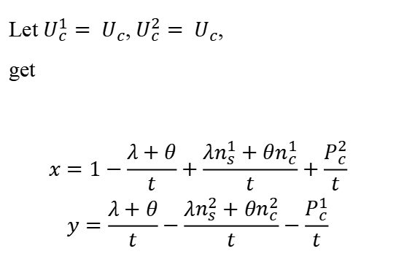
Model-Calculations
Let $U_{c}^{1}= U_{c}$,${U_{c}^{2}= U}_{c}$,
get
$$\begin{aligned}x=1−\frac{λ+θ}{t}+\frac{λn_{s}^{1}+θn_{c}^{1}}{t}+\frac{P_{c}^{2}}{t} \\ y=\frac{λ+θ}{t}−\frac{λn_{s}^{2}+θn_{c}^{2}}{t}−\frac{P_{c}^{1}}{t}\end{aligned}$$
Let $U_{s}^{1}= U_{s}^{2}$,
get
$$\begin{aligned}z=\frac{1}{2}+\frac{1}{2t}×[λ(n_{1}^{c}−n_{2}^{c})−θ(n_{s}^{1}−n_{s}^{2})−(P_{s}^{1}−P_{s}^{2})]\end{aligned}$$

Slide 9
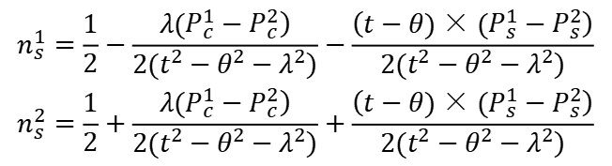
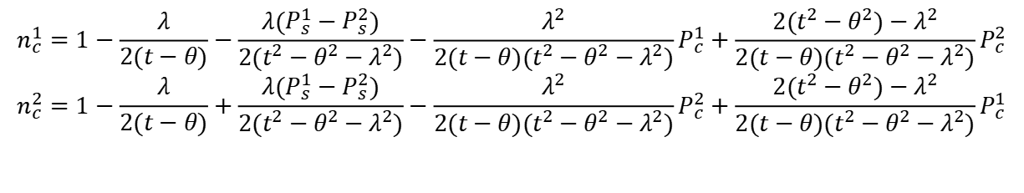
Model-Calculations
· The number of members
$$\begin{aligned}n_{c}^{1}=1−\frac{λ}{2(t−θ)}−\frac{λ(P_{s}^{1}−P_{s}^{2})}{2(t^{2}−θ^{2}−λ^{2})}−\frac{λ^{2}}{2(t−θ)(t^{2}−θ^{2}−λ^{2})}P_{c}^{1}+\frac{2(t^{2}−θ^{2})−λ^{2}}{2(t−θ)(t^{2}−θ^{2}−λ^{2})}P_{c}^{2}\end{aligned}$$
$$\begin{aligned}n_{c}^{2}=1−\frac{λ}{2(t−θ)}+\frac{λ(P_{s}^{1}−P_{s}^{2})}{2(t^{2}−θ^{2}−λ^{2})}−\frac{λ^{2}}{2(t−θ)(t^{2}−θ^{2}−λ^{2})}P_{c}^{2}+\frac{2(t^{2}−θ^{2})−λ^{2}}{2(t−θ)(t^{2}−θ^{2}−λ^{2})}P_{c}^{1}\end{aligned}$$
$$\begin{aligned}&n_{s}^{1}=\frac{1}{2}−\frac{\left.λ(P_{c}^{1}−P_{c}^{2}\right)}{\left.2(t^{2}−θ^{2}−λ^{2}\right)}−\frac{\left(t−θ)×(P_{s}^{1}−P_{s}^{2}\right)}{\left.2(t^{2}−θ^{2}−λ^{2}\right)} \\ &n_{s}^{2}=\frac{1}{2}+\frac{\left.λ(P_{c}^{1}−P_{c}^{2}\right)}{\left.2(t^{2}−θ^{2}−λ^{2}\right)}+\frac{\left(t−θ)×(P_{s}^{1}−P_{s}^{2}\right)}{\left.2(t^{2}−θ^{2}−λ^{2}\right)}\end{aligned}$$

Slide 10
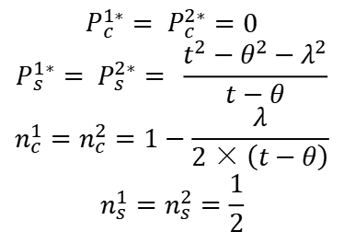

Model-Calculations and Conclusion
· Profit
· Result
$π_{1}=P_{s}^{1}(1−n_{s}^{2})+P_{c}^{1}n_{c }^{1}$
$$π_{2}=P_{c}^{2}n_{c}^{2}+P_{s}^{2}\left(1−n_{s}^{1}\right)$$
$\frac{∂π_{1}}{∂P_{s}^{1}}=0$, $\frac{∂π_{1}}{∂P_{c}^{1}}=0$
$\frac{∂π_{2}}{∂P_{s}^{2}}=0$, $\frac{∂π_{2}}{∂P_{c}^{2}}=0$
$$P_{c}^{1∗}= P_{c}^{2∗}=0$$
$$P_{s}^{1∗}= P_{s}^{2∗}= \frac{t^{2}−θ^{2}−λ^{2}}{t−θ}$$
$$n_{c}^{1}=n_{c}^{2}=1−\frac{λ}{2×\left(t−θ\right)}$$
$$n_{s}^{1}=n_{s}^{2}=\frac{1}{2}$$
Conclusion
· Half of the shops choose platform 1 (or platform2) respectively
· For consumers, platforms set the price at 0
· Platforms want to attract as more consumers as possible

Slide 11
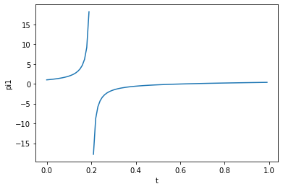

Model-Image
Set $λ$ = 0.6, $θ$ = 0.2
Profit increases by t. (t < 0.2)

Slide 12
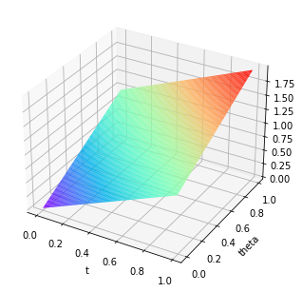

Model-Image
Set $λ$ = 0.6，$θ$ $∈ \left[0, 1\right]，$t $∈ \left[0, 1\right]$
Profit increases by $θ$.

Slide 13
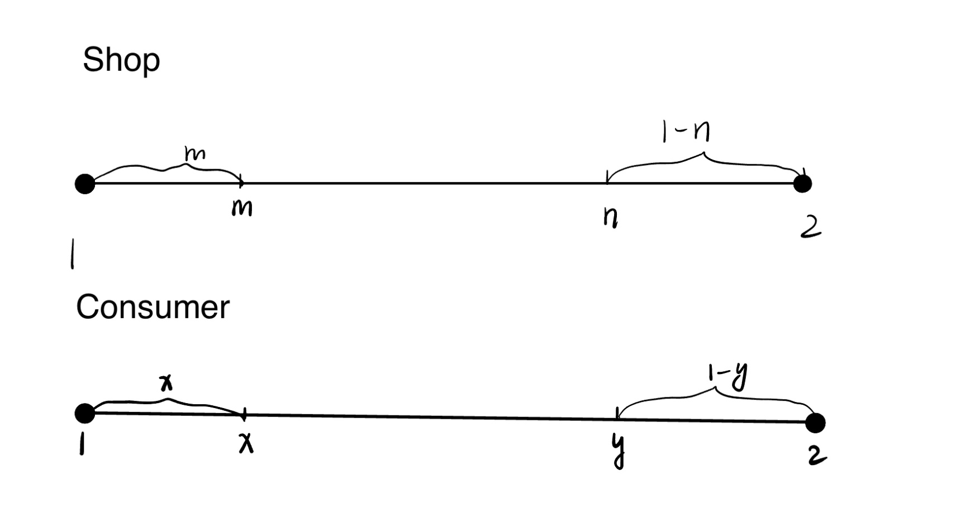



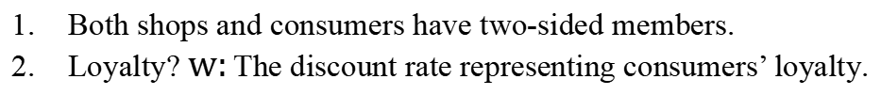
Model-Extension
Extension
Both shops and consumers have two-sided members.
Loyalty? $w:\text{The} \text{discount} \text{rate} \text{representing} \text{consumers}\text{’ }\text{loyalty}\text{.}$
$$n_{s}$$
$$n_{c}$$

Slide 14

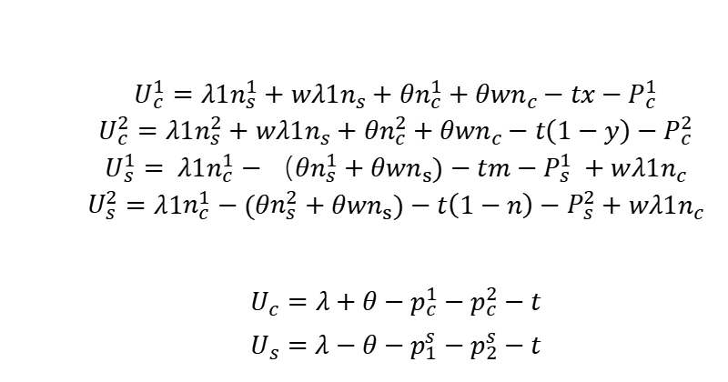
Model-Extension-Calculation
Utility Function
Distance Expression
$$\begin{aligned}U_{c}^{1}=λ1n_{s}^{1}+wλ1n_{s}+θn_{c}^{1}+θwn_{c}−tx−P_{c}^{1} \\ U_{c}^{2}=λ{1n}_{s}^{2}+wλ1n_{s}+θn_{c}^{2}+θwn_{c}−t\left(1−y\right)−P_{c}^{2} \\ U_{s}^{1}= λ1n_{c}^{1}−（θn_{s}^{1}+θwn_{s})−tm−P_{s}^{1} +wλ1n_{c} \\ U_{s}^{2}=λ1n_{c}^{1}−(θn_{s}^{2}+θwn_{s})−t\left(1−n\right)−P_{s}^{2}+wλ1n_{c}\end{aligned}$$
$$\begin{aligned}U_{c}=λ+θ−p_{c}^{1}−p_{c}^{2}−t\end{aligned}$$
$$\begin{aligned}U_{s}=λ−θ−p_{1}^{s}−p_{2}^{s}−t\end{aligned}$$
$$n_{c}^{1}= x$$
$$n_{c}^{2}= 1−y$$
$$n_{s}^{1}= m$$
$$n_{s}^{2}= 1−n$$

Slide 15
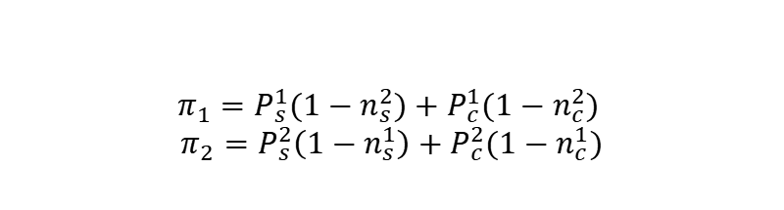

Model-Extension-Calculation
· Profit of the Two Companies
· FOC(First Order Condition)
$$π_{1}=P_{s}^{1}(1−n_{s}^{2})+P_{c}^{1}{(1−n}_{c}^{2})$$
$$π_{2}=P_{s}^{2}\left(1−n_{s}^{1}\right)+P_{c}^{2}{(1−n}_{c}^{1})$$
$$\frac{∂π_{1}}{∂P_{s}^{1}}=0 \frac{∂π_{1}}{∂P_{c}^{1}}=0$$
$$\frac{∂π_{2}}{∂P_{s}^{2}}=0 \frac{∂π_{2}}{∂P_{c}^{2}}=0$$

Slide 16
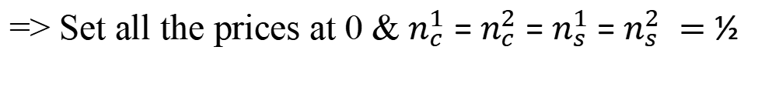

Result
· Result
$$P_{c}^{1}=P_{s}^{2}=P_{c}^{1}=P_{c}^{2}$$
$$= \frac{λ_{1}^{3}w^{2}−2λ_{1}^{3}w−λ_{1}^{2}tw^{2}+λ_{1}^{2}θw^{2}−2λ_{1}^{2}θw+2λ_{1}t^{2}w+λ_{1}θ^{2}w^{2}−2λ_{1}θ^{2}w+2t^{2}θw−tθ^{2}w^{2}+θ^{3}w^{2}−2θ^{3}w}{−λ_{1}^{2}w^{2}+4λ_{1}^{2}w−4λ_{1}^{2}+4t^{2}−θ^{2}w^{2}+4θ^{2}w−4θ^{2}}$$
If w = 0?
=> Set all the prices at 0 & $n_{c}^{1}$ = $n_{c}^{2}$ = $n_{s}^{1}$ = $n_{s}^{2} =$ ½

Slide 17
References
$$[1] Armstrong,M..Competition in Two−sided Markets[J].RAND Journal of Economics,2006,37(3):668−691.$$
[2]高予倩. 双边市场理论视角下我国外卖O2O平台定价策略研究[D].四川省社会科学院,2020.DOI:10.27346/d.cnki.gssky.2020.000008.

Slide 18
Thanks

